Slide 1
AIRLINES YIELD MANAGEMENT SYSTEM
Objective :- AI/ML solution that predicts ticket pricing to generate maximum revenue

Slide 2
Why there's a need for such system?
TRADE-OFF
Keeping prices of the ticket too low or constant leads to uncertainty to adapt if the operating costs and other cost involved get changed affecting the revenue.
Whereas on the other hand keeping high ticket prices can lead to lower seats bookings again affecting the revenue.
*Ultimately in both scenarios the airlines would be on losing side for revenue.

Slide 3
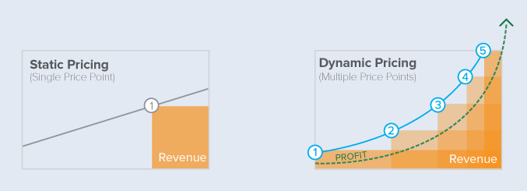
Solution
A data driven system which can dynamically adapt to the changing situations to predict the right ticketing price for each bookings.

Slide 4
Contributing Factors to Pricing of tickets
Schedule of Flight
1.Day of Week
2.Time of the Day
3.Frequency
4.No. of flights for same route
5.Flight Duration
6.No. of days from Departure
User Tracking
1.Site Traffic
2.Search Query
3.Rate of Flight bookings per week
4.Region
Other Factors:-
1.Special Events
2.Weather Conditions
3.Promotional offers
4.Seat Availability
Flight Operations
1.Crude Oil Price
2.Maintenance Cost
3.Cabin Crew Cost
4.Interest Rates
Competitors
1.For similar route , prices of top 3 flights
2.Discount Percentages

Slide 5
Using the contributing features to predict the ticket price
Schedule of Flight
Flight Operations
REGRESSION
MODEL
User Trackings
Predicted Ticket Price
External Factors
Competition

Slide 6
Machine Learning Model to be Used:-
Since the ticket price prediction is a regression problem we can use regression models such as
1.Decision Tree Regressor
2.Random Forest Regressor
3.Support Vector Machines.
4.Linear Regression

Slide 7
Expected Relationships between Features
1.As the bookings are near to the departure date prices will increase.
2.Change in ticket prices as per the seat availability in the flight.
3.Different prices based on flight timings, day of the week.
4.Higher Bookings Rate on special events,festivals,etc.
5.Lesser prices for routes having multiple flight options.
6.Pattern Based on Regions

Slide 8
ROLE OF OPTIMIZATION
Mathematically the optimization problem here is to,
Maximize Revenue (P)
->
Subject to variable ticket price (pt),
Calculated based on features (Flight Schedule , User trackings , Competitors , Flight Operations and Other Factors).

Slide 9


